Slide 1
Federal Sentencing Primer
APRIL 2021

Slide 2
What determines a federal sentence?
Applicable sentencing statute
Statutory maximum term of imprisonment
Statutory minimum term of imprisonment
Fine
Supervised release term
Special Assessment
U.S. Sentencing Commission Guidelines Manual (“the guidelines”)
Advisory guidelines range
Departures
Judicial discretion
Factors in 18 U.S.C. §3553(a)
Variances

Slide 3
1. Applicable Sentencing Statute
Statutory maximum term of imprisonment
Dictated by statute defining the offense or a related penalty provision
E.g., whoever violates the mail fraud statute “shall be fined under this title or imprisoned not more than 20 years, or both” 18 U.S.C. § 1341
Some statutes have increased statutory maximum sentences if certain “sentencing factors” are proven
E.g., whoever possesses child pornography “shall be imprisoned not more than 10 years,” but if “the offense involved a prepubescent minor or a minor who had not attained 12 years of age, such person shall be . . . imprisoned for not more than 20 years” 18 U.S.C. §2252A(b)(2)
Federal courts cannot sentence above the statutory maximum
They can, however, sentence an offender consecutively for multiple offenses. See 18 USC § 3584

Slide 4
1. Applicable Sentencing Statute, cont.
Statutory minimum term of imprisonment
Some statutes set out a mandatory minimum sentence
E.g., certain Title 21 drug offenses based on quantity and drug type; certain Title 8 alien smuggling offenses; and certain arson offenses
Some mandatory minimum sentences have no range
E.g., aggravated identify theft, 18 U.S.C. § 1028A, carries a 2-year sentence
Some mandatory minimum sentences must be imposed consecutively to other terms of imprisonment
E.g., use or possession of a firearm in connection with a crime of violence or drug trafficking offense, 18 U.S.C. § 924(c)

Slide 5
1. Applicable Sentencing Statute, cont.
Statutory minimum terms of imprisonment, cont.
Federal courts cannot sentence below the statutory mandatory minimum unless
The safety valve provision – 18 U.S.C. § 3553(f)—applies in a drug case; or
The government moves under 18 U.S.C. § 3553(e) to credit an offender for providing “substantial assistance in the investigation or prosecution of another person who has committed an offense”

Slide 6
1. Applicable Sentencing Statute, cont.
Other sentencing components governed by statute
Term of supervised release (post-prison term of judicial supervision)
Generally, supervised release term discretionary with court up to a maximum term set by (a) classification of the offense under 18 U.S.C. § 3559; and (b) maximum term of supervised release related to that classification under 18 U.S.C. §3559
Drug and child exploitation/child pornography offenses have mandatory minimum terms of supervised release, up to life, set by statute
Fine
Maximum generally dictated by the “alternative fines provision” in 18 U.S.C. § 3571, and classification of the offense under 18 U.S.C. § 3559
With drug offenses, maximum is generally dictated by the statute defining the offense
Special assessment
Monetary penalty per count of conviction under 18 U.S.C. § 3013; determined by whether offense is felony or misdemeanor
Restitution
18 U.S.C. §3664 governs procedure for issuance and enforcement

Slide 7
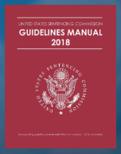
2. The Guidelines
Background
Most current version became effective November 1, 2018
U.S. Sentencing Commission currently lacks a voting quorum to make changes
Judges must consider the advisory guidelines range when imposing sentence

Slide 8
2. The Guidelines, cont.
Calculating the “guidelines range”
Set out in months in the “sentencing table”
Determined by a convicted offender’s
Offense level (along the y axis of the table)
Criminal history category (along the x axis of the table)
Some variables in the calculation may be litigated

Slide 9
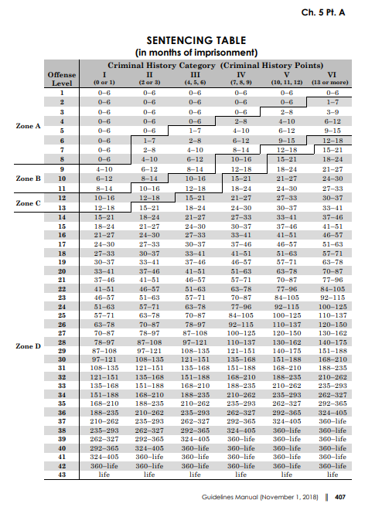

Slide 10
2. The Guidelines, cont.
The Manual
Chapter One
Introduction
Application instructions
Other generally applicable instructions
Chapter Two
Offense-specific instructions [Base offense level and specific offense characteristics]
Cross-references
Chapter Three
Adjustments
Multiple Counts
Acceptance of Responsibility

Slide 11
2. The Guidelines, cont.
The Manual, cont.
Chapter Four
Criminal History Category
Career Offenders and Criminal Livelihood Guidelines
Chapter Five
Sentencing Table
Sentencing Rules
Departures
Chapter Six
Sentencing Procedures
Plea Agreements
Crime Victims' Rights

Slide 12
2. The Guidelines, cont.
The Manual, cont.
Chapter Seven
Violations of Probation and Supervised Release
Chapter Eight
Sentencing of Organizations
Table

Slide 13
2. The Guidelines, cont.
Determining the “offense level”
Base offense level
+ specific offense characteristics
+ adjustments
+ grouping of multiple counts
– credit for acceptance of responsibility
= “total offense level”

Slide 14
2. The Guidelines, cont.
Useful tools
Federal Sentencing Guidelines Calculator
https://www.sentencing.us/
Drug quantity calculator
https://guidelines.ussc.gov/dol
Drug conversion calculator
https://guidelines.ussc.gov/de

Slide 15
2. The Guidelines, cont.
Determining the “offense level”
Application instructions in U.S.S.G. §1B1.1(a)(1) through (5)
Determine the applicable offense-specific guideline provision in Chapter 2
Use Appendix A – Statutory Index
Using Chapter 2, determine the base offense level and any specific offense characteristics
Apply any adjustments from Chapter 3
If there are multiple counts of conviction, apply the grouping rules in Part D of Chapter 3
If applicable, apply the “acceptance of responsibility” adjustment(s) in Part E of Chapter 3

Slide 16
2. The Guidelines, cont.
Determining the total offense level
“Specific offense characteristics”
Enhancements to the base offense that relate to that particular crime and guidelines provision
“Adjustments” under Chapter 3
Part A: Victim-Related Adjustments
Part B: Role in the Offense
Can result in an increase or decrease
Part C: Obstruction and Related Adjustments
Part D: Multiple Counts
Grouping rules
Part E: Acceptance of Responsibility
Third level only applies where offense level is at least 16

Slide 17
2. The Guidelines, cont.
Criminal History Category
Determine “criminal history points” under U.S.S.G. §4A1.1
See U.S.S.G. §4A1.2: Definitions and Instructions for Computing Criminal History
Determine Criminal History Category
0 or 1 points = CHC I
2 or 3 points = CHC II
4, 5, or 6 points = CHC III
7, 8, or 9 points = CHC IV
10, 11, or 12 points = CHC V
13 or more points = CHC VI

Slide 18
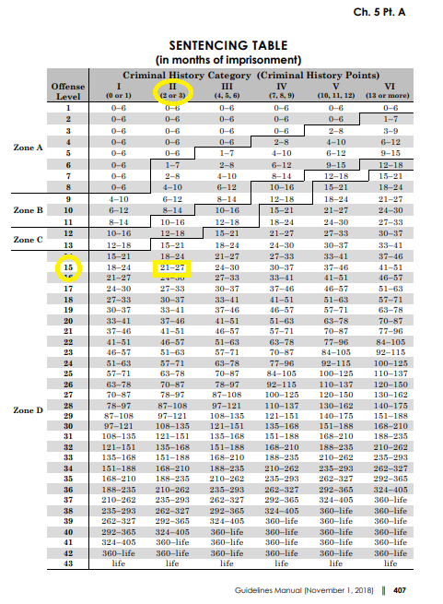

Slide 19
2. The Guidelines, cont.
Sentencing options
After determining the applicable range, determine which “zone” the offender is in (A through D) and refer to Chapter 5, Parts B through G to determine sentencing options and requirements
Probation
Imprisonment
Supervised release
Restitution, Fines, Assessments, Forfeitures
Options (community confinement; home detention; “shock” incarceration; etc.)

Slide 20
2. The Guidelines, cont.
Departures
Determine whether a “departure” is warranted under Parts H and/or K of Chapter 5
Substantial Assistance Departures under U.S.S.G. §5K1.1
Government motion required
Similar to 18 U.S.C. § 3553(e) motions
Departures were permissible before United States v. Booker, 543 U.S. 220 (2005) made guidelines advisory instead of mandatory

Slide 21
2. The Guidelines, cont.
Interplay between statutes and guidelines
General rule: statutory rules trump both the guidelines and sentencing court discretion – the statutory limit becomes the guideline sentence. See U.S.S.G. §5G1.1
E.g., where the guidelines calculation results in an advisory range of 37-46 months, but the offense carries a three-year maximum sentence, the guideline sentence is 36 months. See U.S.S.G. §5G1.1(a)
E.g., where the guidelines calculation results in an advisory range of 37-46 months, but the offense carries a five-year mandatory minimum sentence, the guideline sentence is 60 months See U.S.S.G. §5G1.1(b)

Slide 22
2. The Guidelines, cont.
Interplay between statutes and guidelines, cont.
Where there are multiple counts, the court can stack the prison terms for each count "to the extent necessary" to achieve the total sentence recommended by the guidelines. See U.S.S.G. §5G1.2(d)
E.g., where guidelines calculation results is an advisory range of 324-405 months, and there are three offenses, each carrying twenty-year maximum prison terms, the court may run the terms for each count consecutively to impose a within-guidelines sentence

Slide 23
2. The Guidelines, cont.
Other issues
Guidelines manual in effect at time of sentencing applies unless doing so would violate the Ex Post Facto Clause.
See U.S.S.G. §1B1.11(a)
“One Book” rule
“Where multiple offenses were committed (and the present Manual would trigger an ex post facto violation), the one-book rule dictates that the Guidelines Manual in effect for the most recent offense is applied to all offenses.” United States v. Riggi, 649 F.3d 143, 146 n.2 (2d Cir. 2011)
See § 1B1.11(b)(2)-(3)

Slide 24
3. Judicial discretion
18 U.S.C. § 3553(a) – “Sentencing factors”
The nature and circumstances of the offense and the history and characteristics of the defendant;
The need for the sentence imposed
to reflect the seriousness of the offense, to promote respect for the law, and to provide just punishment for the offense;
to afford adequate deterrence to criminal conduct;
to protect the public from further crimes of the defendant; and
to provide the defendant with needed educational or vocational training, medical care, or other correctional treatment in the most effective manner;
The kinds of sentences available;
[Various guidelines-related considerations]
The need to avoid unwarranted sentence disparities among defendants with similar records who have been found guilty of similar conduct; and
The need to provide restitution to any victims of the offense.

Slide 25
3. Judicial discretion, cont.
Variances
Post-Booker, courts can “vary” from the guidelines.
“Variances” are outside the guidelines system
“Departures” are within the guidelines system
These words are not interchangeable
Variances are based on judicial consideration of the §3553(a) sentencing factors
A court may vary upwards or downwards

Slide 26
Recap: What determines a federal sentence?
Applicable sentencing statute
Statutory maximum term of imprisonment
Statutory minimum term of imprisonment
Fine
Supervised release term
Special Assessment
U.S. Sentencing Commission Guidelines Manual (“the guidelines”)
Advisory guidelines range
Departures
Judicial discretion
Factors in 18 U.S.C. §3553(a)
Variances

